Slide 1
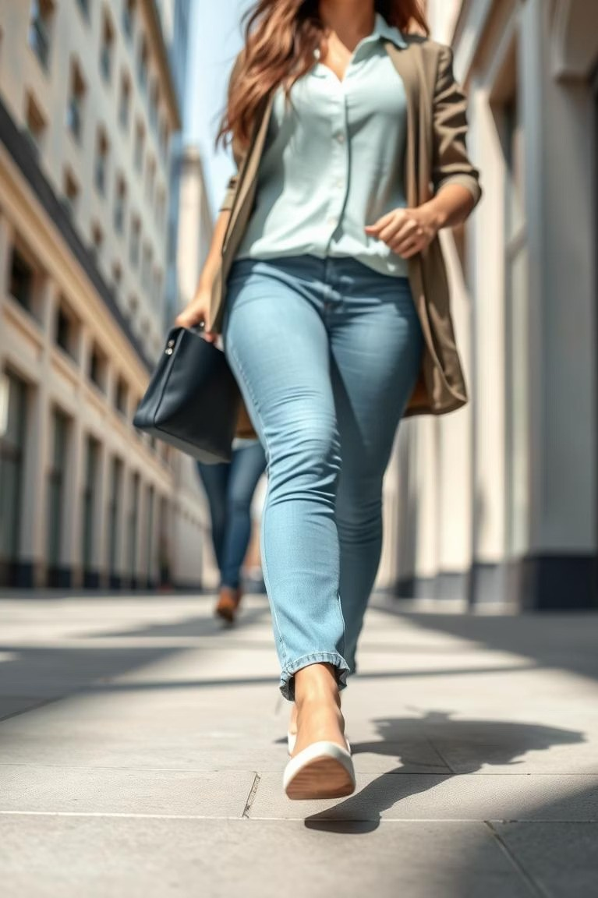
Human Authentication Using Gait Recognition
Explore biometric authentication through unique walking patterns. This method offers a convenient, non-intrusive alternative to passwords or fingerprints. Gait recognition is an emerging technology with strong potential across security and accessibility domains.

Slide 2
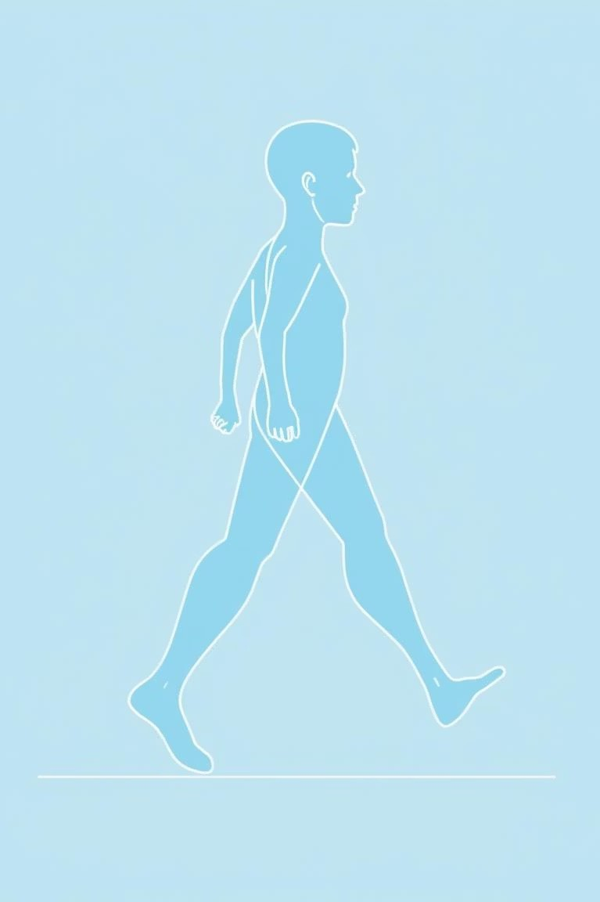
What is Gait Recognition?
Unique Walking Style
Identifies individuals based on how they walk.
Gait Components
Considers stride length, speed, and body dynamics.
Consistent Patterns
Relies on distinctive, reproducible walking characteristics.

Slide 3
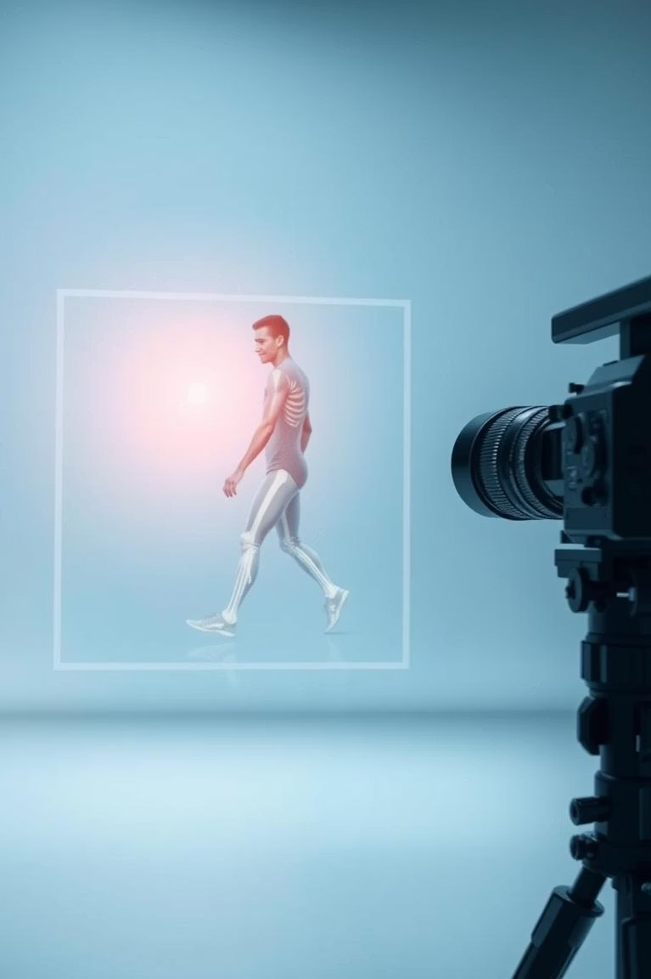
How Gait Recognition Works
Data Acquisition
Collected via cameras or wearable sensors.
Feature Extraction
Key gait parameters are identified.
Classification
Matches gait patterns to known identities.
Accuracy
Achieves 85-95% accuracy in controlled settings.

Slide 4
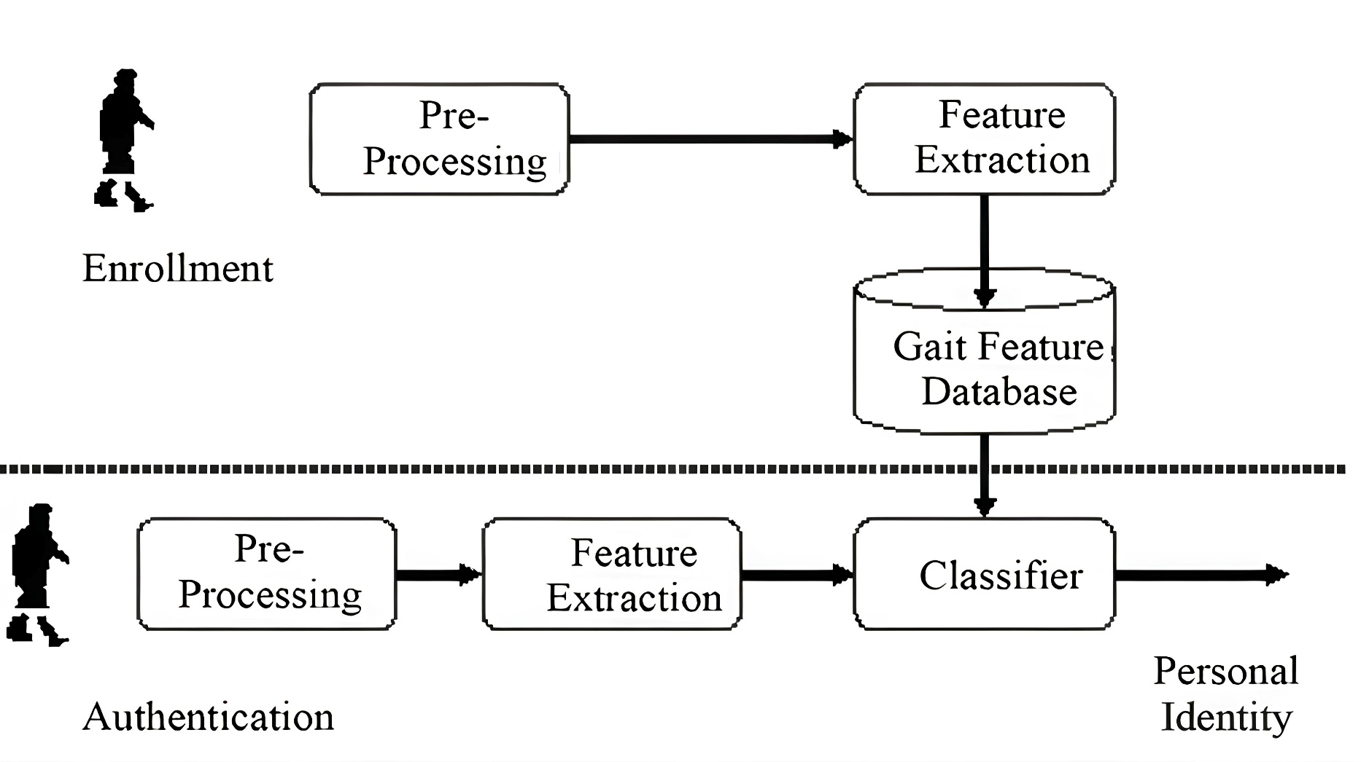
Architecture diagram :-
Resources

Slide 5
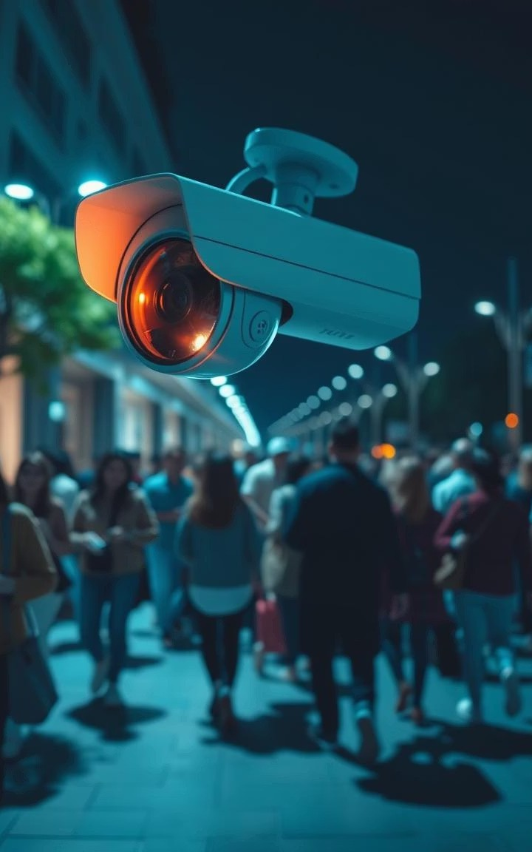
Advantages of Gait Recognition
Non- Intrusive
Data is captured passively without disturbing users.
Useful in Forensics and Crime Investigation
Can help identify suspects based on recorded footage where other biometrics are not visible.
Remote Detection
Works effectively from a distance and low resolution.
No Special Equipment Needed
Standard video cameras are sufficient no need for specialized sensors or scanners.

Slide 6
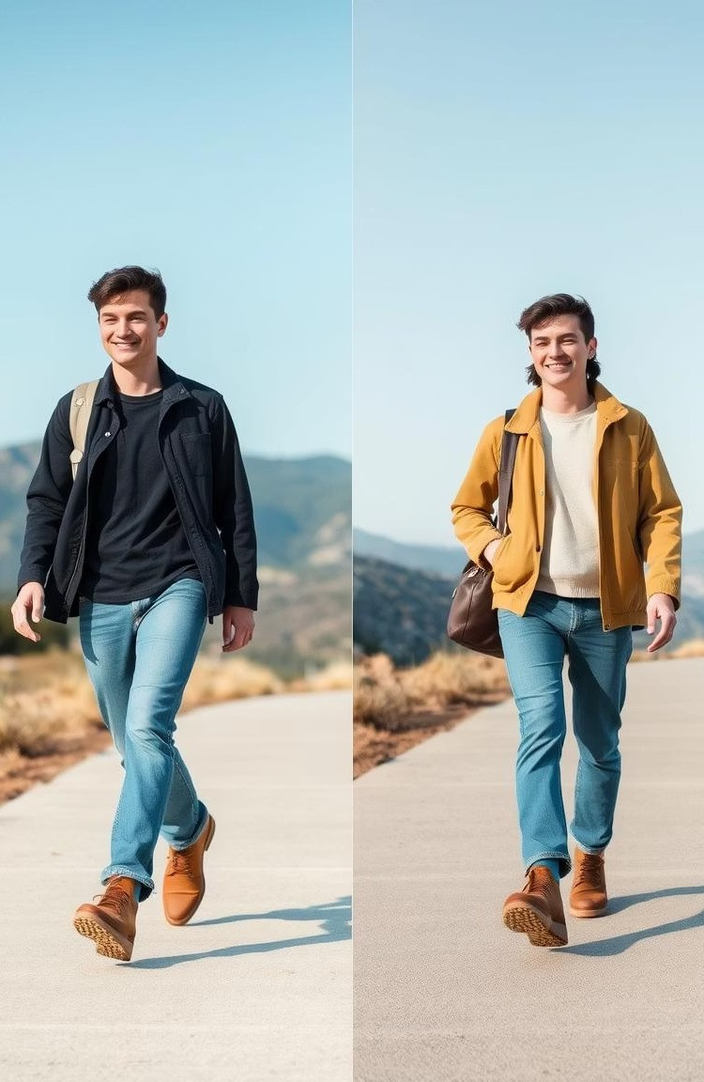
Challenges of Gait Recognition
Gait Variability
Affected by clothing, speed, and terrain changes.
Environmental Effects
Lighting, angles, and obstructions reduce reliability.
Data Quality
Low-res or noisy video complicates analysis.
Computational Demands
Processing large datasets requires advanced algorithms.

Slide 7
Applications of Gait Recognition
Security
Access control systems Surveillance and forensics
Healthcare
Patient mobility tracking Detecting neurological disorders
Accessibility & Robotics
Assists visually impaired users
Enables personalized robot interactions

Slide 8
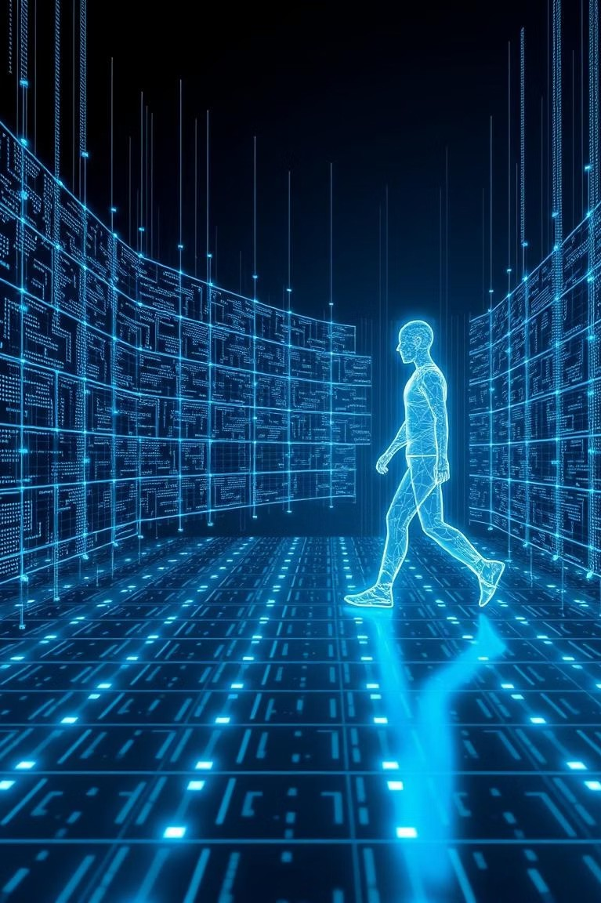
Recent Advances and Future Trends
OpenCV-python:-
Capturing video from webcam, processing video frames.
NumPy:-
Numerical operations and matrix manipulation.
MediaPipe:-
Real-time pose estimation to extract body keypoints.
Scikit-learn:-
Model training, classification, feature scaling, and encoding.
Joblib:-
Saving and loading trained models (scaler, classifier, encoder).

Slide 9
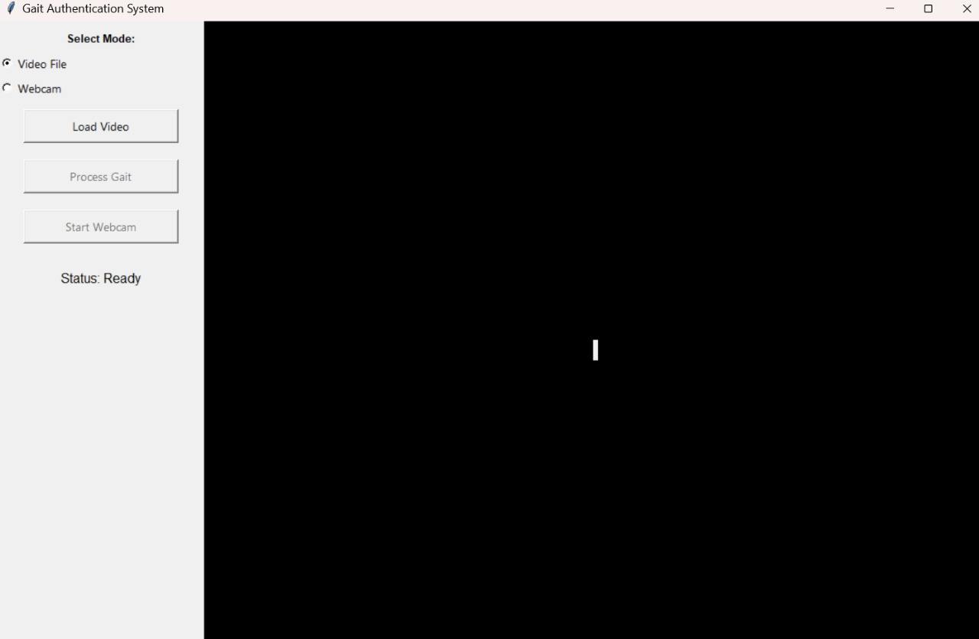
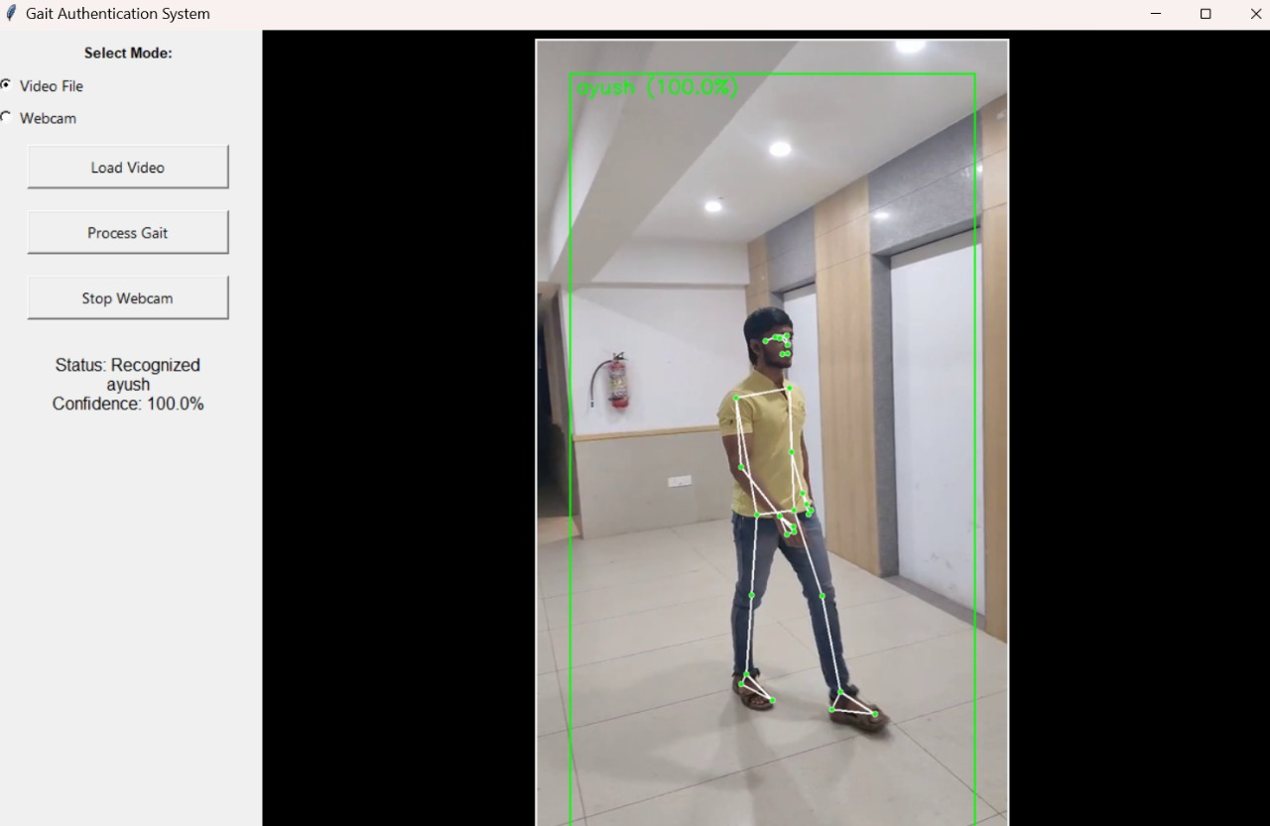
Output:-

Slide 10
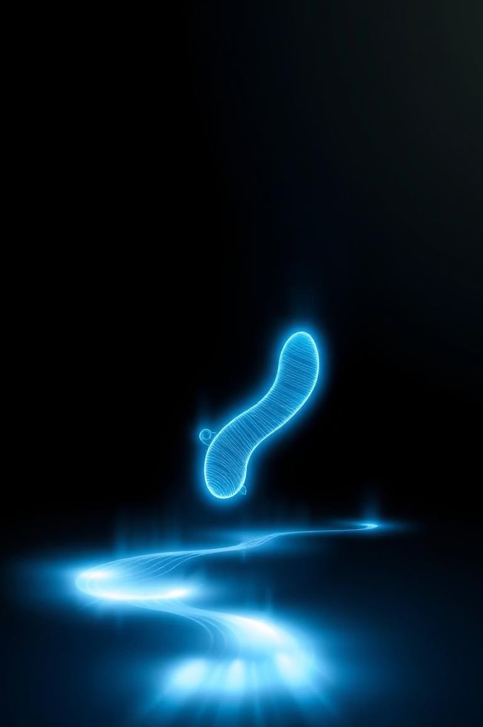
Conclusion
Gait recognition is a special and easy way to identify people by how they walk. It does not need passwords or fingerprints. This new technology can help in areas like safety, health, and more. Using gait can make how we use devices and stay safe better all over the world.

Slide 11
Thank You

